Slide 1

Monogenic Diabetes: The genetic connection
Linda McCarthy RN BSN
mccartlk@alverno.edu
MSN 621, Spring 2010
Alverno College

Slide 2

Tutorial Directions
Click on to go to previous slide.
Click on to go to next slide or section.
Click on to go back to home page.
Click on or hover over the underlined words for explanation.
http://www.free-clipart-pictures.net/school_clipart.html

Slide 3

Objectives of tutorial
After completing this tutorial the learner will have a better understanding of Monogenic Diabetes and be able to recognize the presenting symptoms and pattern of inheritance of monogenic diabetes. They will understand the difference between type 1, type 2 and Monogenic Diabetes.
Topics included:
  Signs / symptoms.
  Genetic inheritance and pathogenesis
  Genetic Testing / Genetic Counseling
  Management / treatment
Image retrieved from Microsoft clipart, 2007

Slide 4
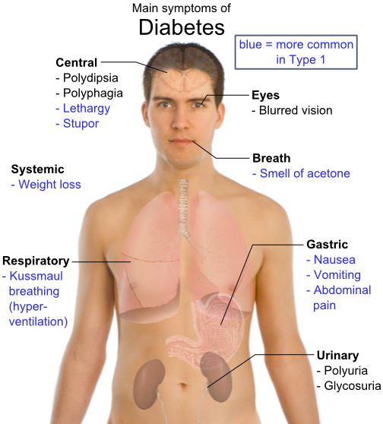
Review of Diabetes Classification
I. Type 1 diabetes: characterized by destruction of the pancreatic beta cells
An absolute lack of insulin, an elevation in blood glucose and a breakdown of fats and proteins.
Prone to develop diabetic ketoacidosis (DKA)
Porth & Matfin, 2009
Image retrieved with permission from: http://en.wikipedia.org/wiki/Diabetes

Slide 5
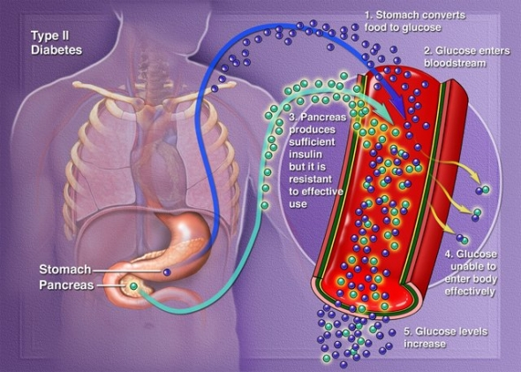
Diabetes Classifications, continued
II. Type 2 diabetes:
Insulin deficiency
Impaired ability of the tissues to use insulin (insulin resistance) and / or impaired release of insulin caused by beta cell dysfunction.
Accounts for about 90- 95% of diabetes cases.
Retrieved with permission from: http://whatisdiabetes.us/type2diabetes052309.jpg
Porth & Matfin, 2009

Slide 6
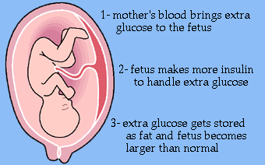
III. Gestational Diabetes
Any degree of glucose intolerance with onset or first recognition during pregnancy.
Caused by a combination of insulin resistance and impaired insulin secretion.
Porth & Matfin, 2009
Image retrieved with permission from http://www.healthsystem.virginia.edu/internet/diabetes/description.cfm

Slide 7
IV. Other types of Diabetes
1. Diseases of exocrine pancreas, for example pancreatitis, neoplasm, cystic fibrosis.
2. Endocrine disorders such as acromegaly & Cushing syndrome.
3. Infections such as congenital rubella & cytomegalovirus.
4. Genetic defects in beta cell function, for example, glucokinase. MODY is in this category.
Porth & Matfin, 2009

Slide 8
Criteria for the diagnosis of diabetes mellitus
1. A1C >6.5%. OR
2. Fasting Plasma Glucose 126 mg/dl (7.0 mmol/l). Fasting is defined as no caloric intake for at least 8 hours. OR
3. Two-hour plasma glucose 200 mg/dl (11.1 mmol/l) during an OGTT. OR
4. In a patient with classic symptoms of hyperglycemia or hyperglycemic crisis, a random plasma glucose 200 mg/dl (11.1 mmol/l).
*In the absence of unequivocal hyperglycemia, criteria 1–3 should be confirmed by repeat testing.
American Diabetes Association. (2010) Standards of Medical Care in Diabetes

Slide 9
Type 1 Diabetes is the result of?
Let’s Review
Insulin resistance due to impaired ability of the tissues to use insulin.
No, this is type 2 diabetes
Absolute lack of Insulin due to loss of beta cell function.
Yes, type 1 DM is the result of beta cell destruction
c. Genetic condition in which the beta cells do not make enough insulin.
No, this is MODY

Slide 10
Which type of diabetes is most common?
Type 1
No, try again
Type 2
Correct, accts for 90-95%
MODY
No, try again
Gestational Diabetes
No, try again

Slide 11
How is Diabetes Diagnosed?
(Click on letter below for correct answer)
a. 2 Separate Fasting Plasma Glucose levels greater than or equal to126 mg/dl.
b. Symptoms of fatigue, polydypsia and polyuria
No, try again
c. A single A1C level of greater than or equal to 6.5%
No, try again
d. A Finger stick > 126.
Clipart, 2007
No, try again

Slide 12
Correct, Diabetes is diagnosed by 2 fasting blood sugar levels over 126 or 2 A1C levels greater than or equal to 6.5%. It is not diagnosed based on symptoms alone.
Great job!

Slide 13
(Click on letter below for correct answer)
DM is caused by a lack of:
a.
gluconeogenesis
No, try again
b.
glucagon
No, try again
c.
insulin
Correct!
d.
Free Fatty Acids
No, try again
Clipart, 2007

Slide 14
Which of the following is not a symptom
of diabetes
(Click on letter below for correct answer)
a.
polydipsia
No, try again
b.
polyuria
No, try again
Clipart, 2007
c.
Water retention
Correct!
d.
No, try again
polyphagia

Slide 15
Insulin is a hormone produced by what cells?
(Click on letter below for correct answer)
a.
neutrophils
No, try again
b.
No, try again
Red blood cells
c.
beta cells
Correct!
d.
T- cells
No, try again
Clipart, 2007

Slide 16
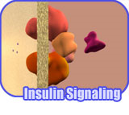
Let’s review Insulin Signaling Pathways
Click the link below for a review of Normal Insulin secretion
http://vcell.ndsu.edu/animations/insulinsignaling/movie-flash.htm
Animation used with permission Dr Phil McClean, NDSU, April, 2010

Slide 17
Case Study: Monogenic diabetes
Autosomal Dominant Inheritance: Family with 4 children. Dad & 2 of the 4 children have MODY.
Clipart, 2007

Slide 18
Diagnosis: father, 1991
Diagnosed at age 29. Thin body habitus.
No symptoms in childhood. Did notice wt loss in college, attributed to exercise. 1 sibling with pre-diabetes.
Grandparents on both sides had “old age onset” diabetes.
Treatment: initially diet / exercise, then sulfonylurea, now Lantus / humalog. No genetic testing done.
Clip art, 2007

Slide 19
Diagnosis: oldest son, 2004
Age 18.
Thin, athletic, runner.
No apparent symptoms
Treatment: initially diet / exercise, added glimiperide, and Lantus. No genetic testing was done.
Clip Art, 2007

Slide 20
Diagnosis: youngest daughter, 2007
Age: 12 in 6th grade.
Blood sugar at home: >350 and initial A1c = 8.5
treated as type 1 with Novolog and Lantus
Genetic testing in 2009 confirmed HNF4 (MODY1).
Clip Art, 2007

Slide 21
What is MODY?
Maturity-onset diabetes of the young (MODY) is a group of genetic disorders that cause diabetes. At this time, 6 different subtypes of MODY have been identified.
first recognized in 1974-1975 by Tattersall (Tattersall, R.B. 1974).
MODY is called Monogenic diabetes and has an autosomal dominant mode of inheritance.
In some cases, the gene mutation is inherited; but in others, the gene mutation develops spontaneously.
Nyunt, et al, 2009

Slide 22
Prevalence of MODY
Clipart, 2007
Exact prevalence not known, estimated to be responsible for 2-5% of cases of non-insulin dependent diabetes. MODY prevalence is underestimated and it is sometimes misdiagnosed as type 2.
Nyunt, et al, 2009

Slide 23
Clinical Features to help differentiate Type 1, Type 2, and MODY
 | Type 1 DM | Type 2 DM | MODY
Frequency | Common | Increasing | 2 – 5% of non - insulin dependent Diabetics
Genetics | Polygenic | Polygenic | Monogenic Autosomal Dominant
Family History | <15% | >50% | 100%
Ethnicity | Different races | Asians, Polynesians, Indigenous Australians | Different races
Age of onset | Throughout Childhood | Post-Puberty | <25 yrs
Nyunt, et. al 2009

Slide 24
Clinical Features to help differentiate Type 1, Type 2, and MODY, continued
 | TYPE 1 | TYPE 2 | MODY
Severity of onset | Acute and severe | Mild | Mild/Asymptomatic
Ketosis / DKA | Common | Uncommon | Rare
Obesity | +/− | >90% | +/−
Acanthosis Nigricans | Absent | Common | Absent
Metabolic Syndrome | Absent | Common | Absent
Auto-immunity | Positive | Negative | Negative
Pathophysiology | β Cell destruction | Insulin resistance and relative insulinopaenia | β Cell dysfunction
Nyunt, et. al 2009

Slide 25
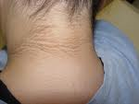

Acanthosis Nigricans
a skin disorder characterized by hyperpigmentation and "velvety" thickening of the skin, particularly of skin fold regions.
It is associated with insulin resistance. Acanthosis nigricans will improve or resolve with treatment of the underlying disorder.
http://fromyourdoctor.com/topic.do?title=Acanthosis+Nigricans&t=6015
Porth, & Matfin, 2009
  http://www.nytimes.com/imagepages/2007/08/01/health/adam/2353Acanthosisnigricansonthehand.html

Slide 26
What are the most common characteristics of MODY?
a. Weight loss, acetone breath, Diabetic Ketoacidosis.
No, this is type 1 diabetes
b. Weight gain , insulin resistance, metabolic syndrome.
No, this is type 2 diabetes
c. Usually discovered during pregnancy.
No, this is gestational diabets
d. Abnormal Beta cell function, often presents in youth, although may not be recognized until early adulthood.

Slide 27
Correct, MODY has autosomal dominant inheritance with abnormal function of beta cells. Hyperglycemia is mild to moderate and can often be treated with oral medication.
Great job!

Slide 28
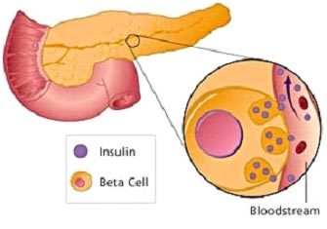
Pathophysiology of Monogenic Diabetes
Caused by mutations in nuclear transcription factors and glucokinase genes which result in Beta cell dysfunction in the production of insulin.
Used with permission:http://www.bodyclinicindonesia.com/library/beta_cell.jpg
Nyunt, et. al , 2009

Slide 29
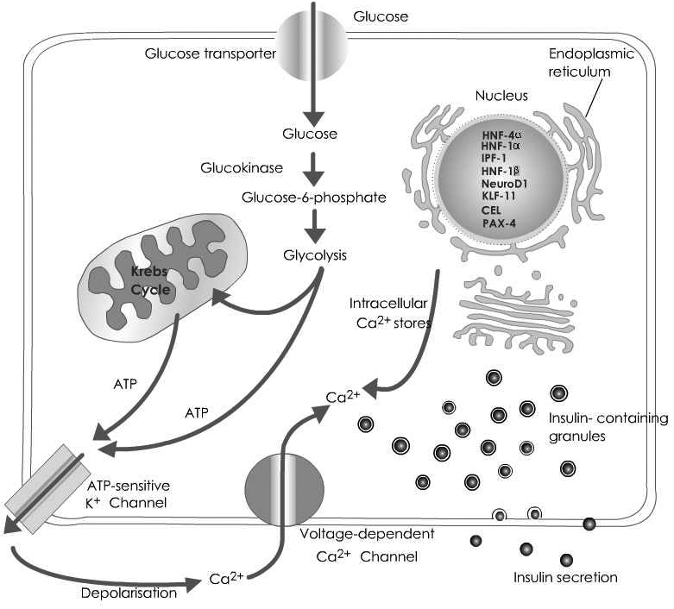
Insulin Production by Pancreatic Beta Cell
Glucose enters cell
Glycolysis makes ATP
ATP production causes K+ channel to close and depolarize the cell
Depolarization opens voltage sensitive Ca2+ channels (Ca2+ enters cell)
Ca2+ influx causes insulin release.
Image used with permission, Dr Nyunt 3/2010.

Slide 30

Inflammation and Insulin Resistance
Obesity is associated with chronic low-level inflammation.
Insulin resistance is the condition in which a normal amount of insulin is inadequate to produce a normal response from fat, muscle and liver cells. This leads to elevated blood glucose
(Porth & Matfin, 2009)
Central obesity
http://healthhabits.files.wordpress.com/2008/05/type-2-diabeetus.jpg (image modified)

Slide 31
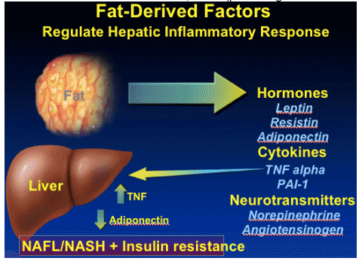
Inflammation and Diabetes
Studies suggest that, “insulin resistance or increased body weight, rather than glycemia or impaired beta cell function, contributes to the proinflammatory state in prediabetic individuals.” Elevation of CRP (C-reactive protein) or PAI-1 (plasminogen activator inhibitor) should be considered predictors of diabetes.
http://www.natap.org/2006/IntCo/011806/fatDerived-1.gif
Festa, et al, 2003

Slide 32

Effects of Aging & Diabetes
Aging is accompanied by 2–4-fold increase in inflammatory mediators such as cytokines. Many factors contribute to this low-grade inflammation, including an increased amount of fat tissue, decreased production of sex steroids, smoking, infections and chronic disorders such as cardiovascular diseases and Alzheimer’s disease. Evidence suggests that aging is associated with a dysregulated cytokine response. Several inflammatory mediators such as tumor necrosis factor-a and interleukin-6 have the potential to induce or aggravate risk factors in age-associated pathology.
Krabbe, et al, 2004
Clipart, 2007

Slide 33
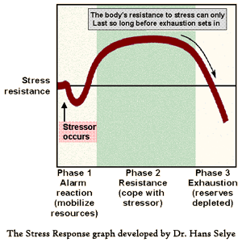
Stress and Diabetes, what’s the relationship?
Stress causes a fight or flight response. The neuroendocrine and immune systems respond.
Catecholamine and coritsol are released to provide increased alertness.
Porth & Matfin, 2009
Image Retrieved from www.mindbodypsychotherapy.net/mbconnection.htm

Slide 34
Stress, continued
Stress hormones that are designed to deal with short-term danger can stay turned on for a long time.
Ability to adapt is determined by many factors: age, health status, nutrition, hardiness and others.
During the stress response, glucose is released from the liver, muscles and stored fat. This causes an elevation in blood glucose. Chronic stress can cause a long term elevation in blood glucose. Porth & Matfin, 2009

Slide 35
Which of these can cause the blood glucose to rise?
Cortisol
yes!
insulin
no
Insulin resistance
yes!
glucagon
Yes!
laughter
no
Dietary indiscretion
yes
exercise
Usually no.
stress
yes
infection
yes

Slide 36
MODY subtypes
MODY Subtypes | Clinical Features
MODY 1: HNF4A | Hepatic Nuclear Transcription Factor 4A gene. Transient hyperinsulinemic Hypoglycemia, familial hyperlipidemia, increased sensitivity to sulfonylurea. Uncommon
MODY 2: GCK | Glucokinase Gene. Mild insulin deficiency, Low birth weight infants (unaffected mothers), Neonatal Diabetes Mellitus in homozygous. common.
MODY 3: HNF1A | Hepatic Nuclear Factor F1A gene. Similar to features of HNF4A. Pancreatic exocrine failure, Increased sensitivity to sulfonylureas, glycosuria. Most common
Used with permission Nyunt, et. al 2009, (modified)

Slide 37
MODY subtypes, cont.
MODY Subtypes | Clinical Features
MODY 4: IPF1 insulin promotor factor 1 | Pancreatic agenesis
MODY 5: HNF1B Hepatic nuclear factor 1B | Congenital anomalies of urinary tract, Agenesis of pancreatic tail and body, Pancreatic exocrine failure
MODY 6: NeuroD1 Neurogenic differentiation 1 | Pancreatic anomalies
OTHER MODY subtypes: -KLF11. Krueppel-like factor 11 | Pancreatic malignancy
-CEL gene (controls both exocrine and endocrine function in the pancreas) | Pancreatic exocrine and endocrine failure
-PAX4 Paried box gene 4 | Diabetes mellitus
Nyunt, et. al 2009

Slide 38
Monogenic Diabetes
What is the most common subtype of MODY? (click on box for answer)
MODY 3 which has a mutation in the Hepatic Nuclear Factor F1A gene
How many classes of MODY are there?
3
4
5
7
6
Yes, 6 subtypes of MODY

Slide 39
Can you identify the genes responsible for MODY?
HNF4A
MODY 1
HNF1A
MODY 3
IPF1
MODY 4
LOL
Ha ha!
SOL
Hope not…
GCK
MODY 2
HNF1B
MODY 5
NEUROD1
MODY 6
IAA
no, Insulin Autoantibodies

Slide 40
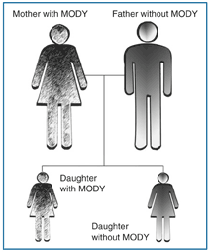
Autosomal Dominant Inheritance
What is the chance of this couple’s children inheriting MODY?
Click on this text for answer.
The affected child will have a 50% chance of passing MODY onto their children.
http://www.diabetes.niddk.nih.gov/dm/pubs/mody/#3

Slide 41
Key Characteristics of MODY:
Click to learn the Key Characteristics
Presentation is non-ketotic hyperglycemia
Lack of auto antibodies
Age of onset < 25 years
Non insulin dependent diabetes, defined by treatment without insulin for 5 years, or measurable C-peptide.
Can be mistaken for type 1 or type 2.

Slide 42
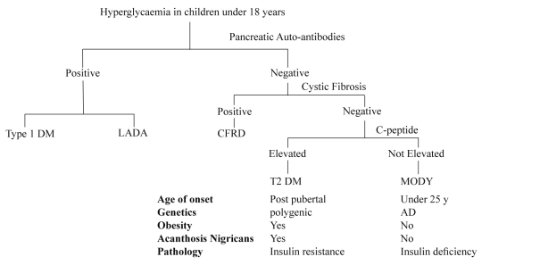
Algorithm for investigation of hyperglycaemia. DM- Diabetes Mellitus, LADA- Latent Autoimmune Diabetes in Adults, CFRD- Cystic Fibrosis Related Diabetes Mellitus, AD- Autosomal Dominant Inheritance.
Nyunt, o, et. al 2009

Slide 43
Why is Monogenic Diabetes difficult to recognize?
Unfamiliarity with importance of family history.
Healthcare professionals’ lack of confidence regarding genetics and other autosomal dominant conditions.
Technical language involved in genetics is confusing for some healthcare providers.
Small patient population. Diabetic Nurse Educator said she had seen 1 case in 14 years of practice. Shepherd, 2001

Slide 44
Treatment
Depends on which type MODY, some can be treated with diet and exercise.
Most will need pharmacological treatment due to progressive deterioration in glycemic control.
Patients with MODY are extremely sensitive to Sulfonylurea which have shown to be 4 times as effective in lowering glucose than metformin. (Hattersly, et al, 2009)

Slide 45

Treatment of MODY, continued
  Some can be maintained on Sulfonylurea for many decades and glycemic control is often better than that achieved on insulin.
  Initial dose is low, ¼ the normal starting dose. (Hattersly, et al, 2009)
Image retrieved from: Microsoft Word Clipart 2003

Slide 46
Sulfonylureas work well in treating MODY
Drugs such as Glipizide, Glyburide and Glimiperide.
Mechanism: Stimulate insulin secretion by closing the Beta cell’s K+ channel causing depolarization and calcium influx.
Side Effects:
  Hypoglycemia
  Rashes
  GI upset
  Hyponatremia
Click to learn the mechanism of action of Sulfonylureas

Slide 47
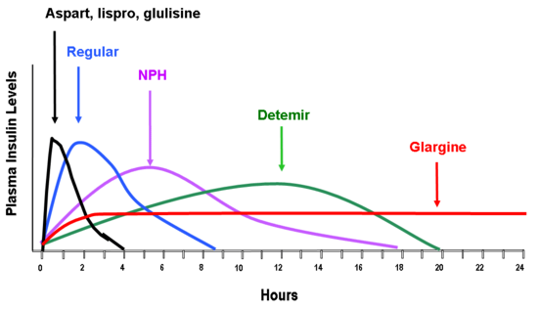
Treatment of MODY, continued
  MODY subtypes HNF1A and HNF4A: approximately 1/3 will require insulin due to progressive beta cell dysfunction. (Nyunt, et al, 2009)
Image retrieved with permission from: http://www.endotext.org/Diabetes/diabetes20/figures/figure7.png

Slide 48

Genetic Testing can be Life Changing
Lilly, diagnosed with type 1 diabetes @ 11months
On insulin pump for years
Saliva DNA test done
+ genetic mutation
Admitted to hospital and weaned off insulin pump
Now on oral medication
http://www.monogenicdiabetes.org/jaffe_story.html

Slide 49
Genetic Testing & Counseling
Positive Implication for treatment: switch to oral agent once mutation is identified!
Treatment geared to specific mutation.
Cost of test: not covered by insurance: $1700
Implications for off spring due to dominant inheritance; 50% chance of passing this on.

Slide 50
Nursing outcomes
Knowledge: Diabetes Management
Provide education re: disease presentation and genetic component. This may involve teaching our colleagues due to unfamiliarity of this disease.
Teach self care techniques re: medication, diet, exercise.
Provide genetic testing information.
Iowa Outcomes project, (2000)

Slide 51
Which these features are related to MODY
a. Mild and usually treated with oral medication
Yes
b. Requires genetic testing to determine subtype
Yes
c. Presents over the age of 50.
No, usually presents < 25 yrs old
d. Accounts for 15% of all type 2 diabetes.
No, MODY is rare and only accounts for 2-5% of type 2

Slide 52
MODY: SUMMARY
Mild diabetes at presentation
Strong family history
Age of onset usually before age 25
Features inconsistent with other types of diabetes: No significant obesity or acanthosis
Sensitivity to Sulfonylurea and may require insulin later in life.

Slide 53


Congratulations you have completed the Monogenic Diabetes Tutorial!

Slide 54
References, Monogenic Diabetes
American Diabetes Association, Standards of medical care in Ddabetes—2010, Diabetes Care, Volume 33, supplement 1, January 2010 S11-s25.
Festa A, Hanley AJ, Tracy RP, D'Agostino, R , & Haffner, S. (2003 ). Inflammation in the prediabetic state is related to increased insulin resistance rather than decreased insulin secretion. Circulation, 108:1822-1830.
Hattersly A., Bruining, J., Sheild, J., Njolstad, p., & Donaghue, K. (2009) The diagnosis and management of monogenic diabetes I children and adolescents. Pediatric Diabetes, 10 (suppl 12), 33-42.
Iowa Outcomes project, (2000) Nursing Outcomes Classification (NOC) (2nd ed.). St. Louis, Missouri: Mosby, Inc.
Krabbe, K.S., Pedersen, M., Bruunsgaard, H. (2004). Inflammatory mediators in the elderly. Experimental Gerontology, (39) 687-699.
Nyunt, o., y, J., McGown, I., Harris, M., Huynh, T., Leong, G., Cowley, D., Cotterill, A., (2009). Investigating Maturity onset diabetes of the young. Clin Biochem Rev. 2009 May; 30(2): 67–74.
Porth, C.M & Matfin, G. (2009) Pathophysiology: Concepts of Altered Health States. Philadelphia: Lippincott Williams & Wilkins.
Shepherd, M., Stride, A., Ellard, S., & Hattersley, A. (2003). Integrating genetics into diabetes care: a new role for DSNs. Journal of Diabetes Nursing, 7(8), 289-292.
Tattersall, R.B., Mild familial diabetes with dominant inheritance. QJ Med 1974/ 43: 339-57. (this reference was taken from the Nyunt, Ohn et all article. Reference #1. )

Slide 55
THANK YOU to those who helped!
My husband Joe, for his patience and willingness to be a guinea pig and tester.
My children because I was “absent from home this semester”
Pat Bowne for her wisdom and help in learning the “tutorial way.” (along with everything else!)
My mother, by her example of hard work, encouraged me to pursue my Master’s Degree.

